Slide 2
Carteret County Economic Outlook
January 12, 2023

Slide 3
Overview
National Economy
Labor market is tight
Inflation is high and driving Fed behavior
Recession is likely
Carteret County
Growing slower than the nation
Tight labor market
Now more than ever, economic developers need to work with educators and workforce officials

Slide 4
Two General Measures Show Inflation is Near a 40-Yr High: Personal Consumption Expenditure Price (PCE) Index and Consumer Price Index (CPI)
Sources: BEA and BLS.
Data through November 2022.

Slide 5
Lockdown Shifted Demand to Goods and Away From Services
Source: BLS

Slide 6
Average Hourly Earnings, +4.6% in December 2022 From Year Ago

Slide 7
Inflation Is Not Good For Long-Term Economic Growth
It is a regressive tax
It distorts decision making
Inventory accumulation
Can lead to deeper recessions
It can lead to recession if Fed continues to raise rates
It can spiral upward with wages rising and inflation expectations ‘unanchored’

Slide 8
Doesn’t Two Consecutive Declines in Real GDP Qualify As Recession?
Quarterly Annualized
Great
Recession
Source: BEA and Chmura

Slide 9
No, Not 2 Straight Declines in GDP NBER is the Arbiter of Recession in U.S.
https://www.chmura.com/blog/five-horsemen-of-a-recession
Sources: BLS, BEA, and Federal Reserve.

Slide 10
Inflation-Adjusted Retail Sales Have Been Flat
Source: Census. Data through Oct 22

Slide 11
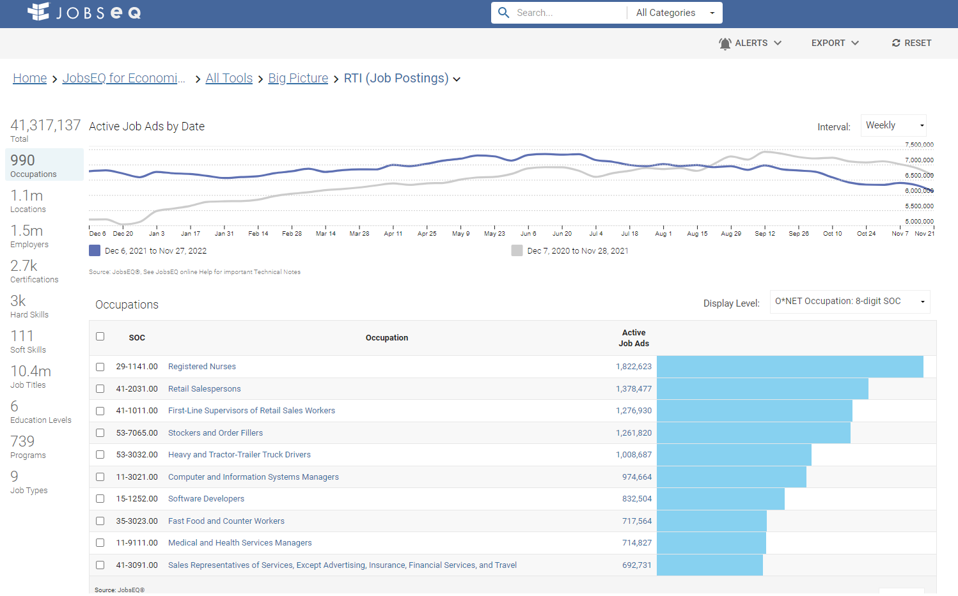
The Economy is Slowing: Job Ads -17.3% Since June 27

Slide 12
Raising Federal Funds Rate Target Too Much Will Invert the Yield Curve
Source: U.S. Treasury.

Slide 13
An Inverted Yield Curve Typically Precedes a Recession (3-Month Bill vs. 10-Yr Note)
Source: U.S. Treasury.

Slide 14
Thoughts From Minneapolis Fed President Kashkari, January 4, 2023
“While I believe it is too soon to definitely declare that inflation has peaked, we are seeing increasing evidence that it may have.”
“In my view, however, it will be appropriate to continue to raise rates at least at the next few meetings until we are confident inflation has peaked.”
Current range is 4.25% to 4.5%; Kashkari looking for about 5.4%
“Wherever that end point is, we won’t immediately know if it is high enough to bring inflation down to 2% in a reasonable period of time.”
“Any sign of slow progress that keeps inflation elevated for longer will warrant, in my view, taking the policy rate potentially much higher.”

Slide 15
Federal Reserve Chair Jerome Powell, August 19, 2022 (quote, emphasis mine)
Restoring price stability will take some time and requires using our tools forcefully to bring demand and supply into better balance. Reducing inflation is likely to require a sustained period of below-trend growth.
Moreover, there will very likely be some softening of labor market conditions.
While higher interest rates, slower growth, and softer labor market conditions will bring down inflation, they will also bring some pain to households and businesses.
These are the unfortunate costs of reducing inflation. But a failure to restore price stability would mean far greater pain
“To bring price increases down to 2%, we may need to tolerate unemployment of 6.5% for two years.” Jason Furman, WSJ, 9-8-22

Slide 16
Historical Context: Double Dip Recession in 1980s

Slide 17
© 2022 Chmura Economics and Analytics

Slide 18
Real GDP Has Slowed—’Official’ Recession in Our Forecast
Quarterly Annualized
Forecast
Source: BEA and Chmura

Slide 19
Summary National Economy
Interest rates expected to rise and hold
Recession is highly likely
Unemployment rate will rise and ease tight labor market
Sub-par growth will last for more than one year

Slide 20
North Carolina’s Employment Growth is Near the Top of the States and Leading Neighbors
#4 North Carolina, 4.3%
#16 SC, 3.7%
#12 TN, 3.8%
#31 VA, 2.7%
#39 DE, 2.3%
#45 MD, 1.9%
Source: Chmura, BLS

Slide 21
North Carolina Employment Growth Typically Faster than the Nation

Slide 22
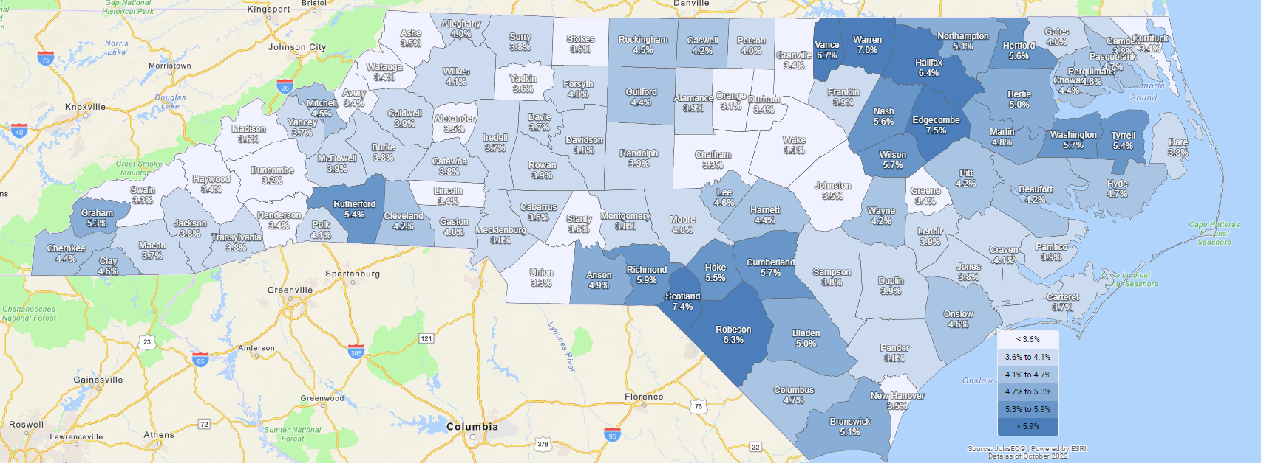
Carteret County: 3.7% Unemployment Rate in October 2022

Slide 23
Carteret County: Per Capita Income Varies By ZCTA (Zip Code)

Slide 24
Labor Shed Is Broader Than the County Borders
45-Minute Drive Time From Beaufort By Block

Slide 25
Population Almost Doubles with 45-Minute Drive Time

Slide 26
Carteret County and Labor Shed Growing Slower than the State

Slide 27
Carteret County 334 Jobs Above Pre-Covid Peak

Slide 28
Wages in Carteret County Lower Than State and Nation

Slide 29
Wages in Carteret County Lower Than State and Nation

Slide 30
Cost of Living is Lower in Carteret County than the Nation but Higher than the State Average

Slide 31
Industry Mix Impacts Wages and Growth

Slide 32
Covid Stimulus Funds Drove Spending and Supported Revenues Over Last 2 Years
Many communities are grappling with how to spend increased revenue
Investing in infrastructure enhances attractiveness of region for expansions
Expand air services
Inventory (land and buildings) for expanding firms
Workforce remains a top priority for firms
Work from home trend opportunity to attract more talent
Continue to invest and promote walkable communities
Support connectivity of K-12 to local firms, especially career technical education

Slide 33
Carteret County Employment Expected To Grow 0.4% On Average Over Next 10 Years Compared with 0.8% in U.S.
 | Current |  |  | 2-Year History |  | 1-Year Forecast
Industry | Empl | Avg Ann Wages | LQ | Empl Change | Ann % | Total Demand | Exits | Transfers | Empl Growth | Ann % Growth
Finance and Insurance | 520 | $79,832 | 0.48 | -50 | -4.5% | 44 | 16 | 30 | -2 | -0.4%
Public Administration | 1,909 | $48,754 | 1.52 | -48 | -1.2% | 174 | 68 | 109 | -4 | -0.2%
Information | 180 | $57,366 | 0.33 | -43 | -10.1% | 17 | 6 | 11 | 0 | 0.2%
Health Care and Social Assistance | 3,457 | $57,586 | 0.89 | -21 | -0.3% | 348 | 149 | 181 | 19 | 0.6%
Manufacturing | 1,006 | $43,533 | 0.46 | -16 | -0.8% | 101 | 36 | 68 | -3 | -0.3%
Management of Companies and Enterprises | 8 | $82,696 | 0.02 | -3 | -14.4% | 1 | 0 | 0 | 0 | -0.3%
Mining, Quarrying, and Oil and Gas Extraction | 10 | $55,455 | 0.11 | 4 | 28.2% | 1 | 0 | 1 | 0 | 2.0%
Utilities | 144 | $71,011 | 1.05 | 8 | 3.0% | 12 | 4 | 9 | -2 | -1.1%
Agriculture, Forestry, Fishing and Hunting | 319 | $31,096 | 0.87 | 11 | 1.7% | 38 | 15 | 23 | -1 | -0.2%
Transportation and Warehousing | 458 | $46,558 | 0.34 | 28 | 3.2% | 52 | 19 | 31 | 2 | 0.4%
Wholesale Trade | 412 | $63,841 | 0.41 | 31 | 4.0% | 42 | 15 | 28 | -1 | -0.3%
Other Services (except Public Administration) | 1,361 | $26,191 | 1.17 | 45 | 1.7% | 160 | 61 | 89 | 10 | 0.7%
Retail Trade | 4,611 | $29,593 | 1.68 | 51 | 0.6% | 566 | 245 | 366 | -45 | -1.0%
Arts, Entertainment, and Recreation | 794 | $27,782 | 1.57 | 71 | 4.8% | 128 | 44 | 63 | 21 | 2.6%
Real Estate and Rental and Leasing | 769 | $48,761 | 1.61 | 87 | 6.2% | 74 | 31 | 44 | -1 | -0.1%
Construction | 2,219 | $46,697 | 1.38 | 97 | 2.3% | 210 | 67 | 144 | -2 | -0.1%
Administrative, Support, Waste Mgmt Remediation Services | 1,486 | $34,570 | 0.85 | 123 | 4.4% | 174 | 65 | 105 | 3 | 0.2%
Professional, Scientific, Technical Services | 1,078 | $65,137 | 0.55 | 135 | 6.9% | 96 | 32 | 61 | 3 | 0.3%
Educational Services | 1,714 | $44,539 | 0.80 | 138 | 4.3% | 162 | 71 | 89 | 1 | 0.1%
Accommodation and Food Services | 4,475 | $23,177 | 1.98 | 432 | 5.2% | 824 | 310 | 430 | 83 | 1.9%
Total - All Industries | 26,929 | $41,258 | 1.00 | 1,080 | 2.1% | 3,016 | 1,145 | 1,777 | 95 | 0.4%
Source: Chmura’s JobsEQ.
Beaufort 45-Minute Drive Time Growing a Slower 0.2% Per Year

Slide 34
Employment in Some Industries Still Shy of Pre-Covid Peak
 | Current |  |  | 2-Year History |  | 1-Year Forecast
Industry | Empl | Avg Ann Wages | LQ | Empl Change | Ann % | Total Demand | Exits | Transfers | Empl Growth | Ann % Growth
Finance and Insurance | 520 | $79,832 | 0.48 | -50 | -4.5% | 44 | 16 | 30 | -2 | -0.4%
Public Administration | 1,909 | $48,754 | 1.52 | -48 | -1.2% | 174 | 68 | 109 | -4 | -0.2%
Information | 180 | $57,366 | 0.33 | -43 | -10.1% | 17 | 6 | 11 | 0 | 0.2%
Health Care and Social Assistance | 3,457 | $57,586 | 0.89 | -21 | -0.3% | 348 | 149 | 181 | 19 | 0.6%
Manufacturing | 1,006 | $43,533 | 0.46 | -16 | -0.8% | 101 | 36 | 68 | -3 | -0.3%
Management of Companies and Enterprises | 8 | $82,696 | 0.02 | -3 | -14.4% | 1 | 0 | 0 | 0 | -0.3%
Mining, Quarrying, and Oil and Gas Extraction | 10 | $55,455 | 0.11 | 4 | 28.2% | 1 | 0 | 1 | 0 | 2.0%
Utilities | 144 | $71,011 | 1.05 | 8 | 3.0% | 12 | 4 | 9 | -2 | -1.1%
Agriculture, Forestry, Fishing and Hunting | 319 | $31,096 | 0.87 | 11 | 1.7% | 38 | 15 | 23 | -1 | -0.2%
Transportation and Warehousing | 458 | $46,558 | 0.34 | 28 | 3.2% | 52 | 19 | 31 | 2 | 0.4%
Wholesale Trade | 412 | $63,841 | 0.41 | 31 | 4.0% | 42 | 15 | 28 | -1 | -0.3%
Other Services (except Public Administration) | 1,361 | $26,191 | 1.17 | 45 | 1.7% | 160 | 61 | 89 | 10 | 0.7%
Retail Trade | 4,611 | $29,593 | 1.68 | 51 | 0.6% | 566 | 245 | 366 | -45 | -1.0%
Arts, Entertainment, and Recreation | 794 | $27,782 | 1.57 | 71 | 4.8% | 128 | 44 | 63 | 21 | 2.6%
Real Estate and Rental and Leasing | 769 | $48,761 | 1.61 | 87 | 6.2% | 74 | 31 | 44 | -1 | -0.1%
Construction | 2,219 | $46,697 | 1.38 | 97 | 2.3% | 210 | 67 | 144 | -2 | -0.1%
Administrative, Support, Waste Mgmt Remediation Services | 1,486 | $34,570 | 0.85 | 123 | 4.4% | 174 | 65 | 105 | 3 | 0.2%
Professional, Scientific, Technical Services | 1,078 | $65,137 | 0.55 | 135 | 6.9% | 96 | 32 | 61 | 3 | 0.3%
Educational Services | 1,714 | $44,539 | 0.80 | 138 | 4.3% | 162 | 71 | 89 | 1 | 0.1%
Accommodation and Food Services | 4,475 | $23,177 | 1.98 | 432 | 5.2% | 824 | 310 | 430 | 83 | 1.9%
Total - All Industries | 26,929 | $41,258 | 1.00 | 1,080 | 2.1% | 3,016 | 1,145 | 1,777 | 95 | 0.4%
Source: Chmura’s JobsEQ.
Beaufort 45-Minute Drive Time Growing a Slower 0.2% Per Year

Slide 35
Strong Competitive Advantage in 7 Sectors Mainly Around Tourism
 | Current |  |  | 2-Year History |  | 1-Year Forecast
Industry | Empl | Avg Ann Wages | LQ | Empl Change | Ann % | Total Demand | Exits | Transfers | Empl Growth | Ann % Growth
Finance and Insurance | 520 | $79,832 | 0.48 | -50 | -4.5% | 44 | 16 | 30 | -2 | -0.4%
Public Administration | 1,909 | $48,754 | 1.52 | -48 | -1.2% | 174 | 68 | 109 | -4 | -0.2%
Information | 180 | $57,366 | 0.33 | -43 | -10.1% | 17 | 6 | 11 | 0 | 0.2%
Health Care and Social Assistance | 3,457 | $57,586 | 0.89 | -21 | -0.3% | 348 | 149 | 181 | 19 | 0.6%
Manufacturing | 1,006 | $43,533 | 0.46 | -16 | -0.8% | 101 | 36 | 68 | -3 | -0.3%
Management of Companies and Enterprises | 8 | $82,696 | 0.02 | -3 | -14.4% | 1 | 0 | 0 | 0 | -0.3%
Mining, Quarrying, and Oil and Gas Extraction | 10 | $55,455 | 0.11 | 4 | 28.2% | 1 | 0 | 1 | 0 | 2.0%
Utilities | 144 | $71,011 | 1.05 | 8 | 3.0% | 12 | 4 | 9 | -2 | -1.1%
Agriculture, Forestry, Fishing and Hunting | 319 | $31,096 | 0.87 | 11 | 1.7% | 38 | 15 | 23 | -1 | -0.2%
Transportation and Warehousing | 458 | $46,558 | 0.34 | 28 | 3.2% | 52 | 19 | 31 | 2 | 0.4%
Wholesale Trade | 412 | $63,841 | 0.41 | 31 | 4.0% | 42 | 15 | 28 | -1 | -0.3%
Other Services (except Public Administration) | 1,361 | $26,191 | 1.17 | 45 | 1.7% | 160 | 61 | 89 | 10 | 0.7%
Retail Trade | 4,611 | $29,593 | 1.68 | 51 | 0.6% | 566 | 245 | 366 | -45 | -1.0%
Arts, Entertainment, and Recreation | 794 | $27,782 | 1.57 | 71 | 4.8% | 128 | 44 | 63 | 21 | 2.6%
Real Estate and Rental and Leasing | 769 | $48,761 | 1.61 | 87 | 6.2% | 74 | 31 | 44 | -1 | -0.1%
Construction | 2,219 | $46,697 | 1.38 | 97 | 2.3% | 210 | 67 | 144 | -2 | -0.1%
Administrative, Support, Waste Mgmt Remediation Services | 1,486 | $34,570 | 0.85 | 123 | 4.4% | 174 | 65 | 105 | 3 | 0.2%
Professional, Scientific, Technical Services | 1,078 | $65,137 | 0.55 | 135 | 6.9% | 96 | 32 | 61 | 3 | 0.3%
Educational Services | 1,714 | $44,539 | 0.80 | 138 | 4.3% | 162 | 71 | 89 | 1 | 0.1%
Accommodation and Food Services | 4,475 | $23,177 | 1.98 | 432 | 5.2% | 824 | 310 | 430 | 83 | 1.9%
Total - All Industries | 26,929 | $41,258 | 1.00 | 1,080 | 2.1% | 3,016 | 1,145 | 1,777 | 95 | 0.4%
Source: Chmura’s JobsEQ.
Beaufort 45-Minute Drive Time Growing a Slower 0.2% Per Year

Slide 36
Employment in Half of the Sectors Expected to Grow
 | Current |  |  | 2-Year History |  | 1-Year Forecast
Industry | Empl | Avg Ann Wages | LQ | Empl Change | Ann % | Total Demand | Exits | Transfers | Empl Growth | Ann % Growth
Finance and Insurance | 520 | $79,832 | 0.48 | -50 | -4.5% | 44 | 16 | 30 | -2 | -0.4%
Public Administration | 1,909 | $48,754 | 1.52 | -48 | -1.2% | 174 | 68 | 109 | -4 | -0.2%
Information | 180 | $57,366 | 0.33 | -43 | -10.1% | 17 | 6 | 11 | 0 | 0.2%
Health Care and Social Assistance | 3,457 | $57,586 | 0.89 | -21 | -0.3% | 348 | 149 | 181 | 19 | 0.6%
Manufacturing | 1,006 | $43,533 | 0.46 | -16 | -0.8% | 101 | 36 | 68 | -3 | -0.3%
Management of Companies and Enterprises | 8 | $82,696 | 0.02 | -3 | -14.4% | 1 | 0 | 0 | 0 | -0.3%
Mining, Quarrying, and Oil and Gas Extraction | 10 | $55,455 | 0.11 | 4 | 28.2% | 1 | 0 | 1 | 0 | 2.0%
Utilities | 144 | $71,011 | 1.05 | 8 | 3.0% | 12 | 4 | 9 | -2 | -1.1%
Agriculture, Forestry, Fishing and Hunting | 319 | $31,096 | 0.87 | 11 | 1.7% | 38 | 15 | 23 | -1 | -0.2%
Transportation and Warehousing | 458 | $46,558 | 0.34 | 28 | 3.2% | 52 | 19 | 31 | 2 | 0.4%
Wholesale Trade | 412 | $63,841 | 0.41 | 31 | 4.0% | 42 | 15 | 28 | -1 | -0.3%
Other Services (except Public Administration) | 1,361 | $26,191 | 1.17 | 45 | 1.7% | 160 | 61 | 89 | 10 | 0.7%
Retail Trade | 4,611 | $29,593 | 1.68 | 51 | 0.6% | 566 | 245 | 366 | -45 | -1.0%
Arts, Entertainment, and Recreation | 794 | $27,782 | 1.57 | 71 | 4.8% | 128 | 44 | 63 | 21 | 2.6%
Real Estate and Rental and Leasing | 769 | $48,761 | 1.61 | 87 | 6.2% | 74 | 31 | 44 | -1 | -0.1%
Construction | 2,219 | $46,697 | 1.38 | 97 | 2.3% | 210 | 67 | 144 | -2 | -0.1%
Administrative, Support, Waste Mgmt Remediation Services | 1,486 | $34,570 | 0.85 | 123 | 4.4% | 174 | 65 | 105 | 3 | 0.2%
Professional, Scientific, Technical Services | 1,078 | $65,137 | 0.55 | 135 | 6.9% | 96 | 32 | 61 | 3 | 0.3%
Educational Services | 1,714 | $44,539 | 0.80 | 138 | 4.3% | 162 | 71 | 89 | 1 | 0.1%
Accommodation and Food Services | 4,475 | $23,177 | 1.98 | 432 | 5.2% | 824 | 310 | 430 | 83 | 1.9%
Total - All Industries | 26,929 | $41,258 | 1.00 | 1,080 | 2.1% | 3,016 | 1,145 | 1,777 | 95 | 0.4%
Source: Chmura’s JobsEQ.
Beaufort 45-Minute Drive Time Growing a Slower 0.2% Per Year

Slide 37
People Transferring Out of Industries Creates Many Job Openings
 | Current |  |  | 2-Year History |  | 1-Year Forecast
Industry | Empl | Avg Ann Wages | LQ | Empl Change | Ann % | Total Demand | Exits | Transfers | Empl Growth | Ann % Growth
Finance and Insurance | 520 | $79,832 | 0.48 | -50 | -4.5% | 44 | 16 | 30 | -2 | -0.4%
Public Administration | 1,909 | $48,754 | 1.52 | -48 | -1.2% | 174 | 68 | 109 | -4 | -0.2%
Information | 180 | $57,366 | 0.33 | -43 | -10.1% | 17 | 6 | 11 | 0 | 0.2%
Health Care and Social Assistance | 3,457 | $57,586 | 0.89 | -21 | -0.3% | 348 | 149 | 181 | 19 | 0.6%
Manufacturing | 1,006 | $43,533 | 0.46 | -16 | -0.8% | 101 | 36 | 68 | -3 | -0.3%
Management of Companies and Enterprises | 8 | $82,696 | 0.02 | -3 | -14.4% | 1 | 0 | 0 | 0 | -0.3%
Mining, Quarrying, and Oil and Gas Extraction | 10 | $55,455 | 0.11 | 4 | 28.2% | 1 | 0 | 1 | 0 | 2.0%
Utilities | 144 | $71,011 | 1.05 | 8 | 3.0% | 12 | 4 | 9 | -2 | -1.1%
Agriculture, Forestry, Fishing and Hunting | 319 | $31,096 | 0.87 | 11 | 1.7% | 38 | 15 | 23 | -1 | -0.2%
Transportation and Warehousing | 458 | $46,558 | 0.34 | 28 | 3.2% | 52 | 19 | 31 | 2 | 0.4%
Wholesale Trade | 412 | $63,841 | 0.41 | 31 | 4.0% | 42 | 15 | 28 | -1 | -0.3%
Other Services (except Public Administration) | 1,361 | $26,191 | 1.17 | 45 | 1.7% | 160 | 61 | 89 | 10 | 0.7%
Retail Trade | 4,611 | $29,593 | 1.68 | 51 | 0.6% | 566 | 245 | 366 | -45 | -1.0%
Arts, Entertainment, and Recreation | 794 | $27,782 | 1.57 | 71 | 4.8% | 128 | 44 | 63 | 21 | 2.6%
Real Estate and Rental and Leasing | 769 | $48,761 | 1.61 | 87 | 6.2% | 74 | 31 | 44 | -1 | -0.1%
Construction | 2,219 | $46,697 | 1.38 | 97 | 2.3% | 210 | 67 | 144 | -2 | -0.1%
Administrative, Support, Waste Mgmt Remediation Services | 1,486 | $34,570 | 0.85 | 123 | 4.4% | 174 | 65 | 105 | 3 | 0.2%
Professional, Scientific, Technical Services | 1,078 | $65,137 | 0.55 | 135 | 6.9% | 96 | 32 | 61 | 3 | 0.3%
Educational Services | 1,714 | $44,539 | 0.80 | 138 | 4.3% | 162 | 71 | 89 | 1 | 0.1%
Accommodation and Food Services | 4,475 | $23,177 | 1.98 | 432 | 5.2% | 824 | 310 | 430 | 83 | 1.9%
Total - All Industries | 26,929 | $41,258 | 1.00 | 1,080 | 2.1% | 3,016 | 1,145 | 1,777 | 95 | 0.4%
Source: Chmura’s JobsEQ.
Beaufort 45-Minute Drive Time Growing a Slower 0.2% Per Year

Slide 38
People Exiting the Industry (Mainly Retiring) Create Many Openings Each Year
 | Current |  |  | 2-Year History |  | 1-Year Forecast
Industry | Empl | Avg Ann Wages | LQ | Empl Change | Ann % | Total Demand | Exits | Transfers | Empl Growth | Ann % Growth
Finance and Insurance | 520 | $79,832 | 0.48 | -50 | -4.5% | 44 | 16 | 30 | -2 | -0.4%
Public Administration | 1,909 | $48,754 | 1.52 | -48 | -1.2% | 174 | 68 | 109 | -4 | -0.2%
Information | 180 | $57,366 | 0.33 | -43 | -10.1% | 17 | 6 | 11 | 0 | 0.2%
Health Care and Social Assistance | 3,457 | $57,586 | 0.89 | -21 | -0.3% | 348 | 149 | 181 | 19 | 0.6%
Manufacturing | 1,006 | $43,533 | 0.46 | -16 | -0.8% | 101 | 36 | 68 | -3 | -0.3%
Management of Companies and Enterprises | 8 | $82,696 | 0.02 | -3 | -14.4% | 1 | 0 | 0 | 0 | -0.3%
Mining, Quarrying, and Oil and Gas Extraction | 10 | $55,455 | 0.11 | 4 | 28.2% | 1 | 0 | 1 | 0 | 2.0%
Utilities | 144 | $71,011 | 1.05 | 8 | 3.0% | 12 | 4 | 9 | -2 | -1.1%
Agriculture, Forestry, Fishing and Hunting | 319 | $31,096 | 0.87 | 11 | 1.7% | 38 | 15 | 23 | -1 | -0.2%
Transportation and Warehousing | 458 | $46,558 | 0.34 | 28 | 3.2% | 52 | 19 | 31 | 2 | 0.4%
Wholesale Trade | 412 | $63,841 | 0.41 | 31 | 4.0% | 42 | 15 | 28 | -1 | -0.3%
Other Services (except Public Administration) | 1,361 | $26,191 | 1.17 | 45 | 1.7% | 160 | 61 | 89 | 10 | 0.7%
Retail Trade | 4,611 | $29,593 | 1.68 | 51 | 0.6% | 566 | 245 | 366 | -45 | -1.0%
Arts, Entertainment, and Recreation | 794 | $27,782 | 1.57 | 71 | 4.8% | 128 | 44 | 63 | 21 | 2.6%
Real Estate and Rental and Leasing | 769 | $48,761 | 1.61 | 87 | 6.2% | 74 | 31 | 44 | -1 | -0.1%
Construction | 2,219 | $46,697 | 1.38 | 97 | 2.3% | 210 | 67 | 144 | -2 | -0.1%
Administrative, Support, Waste Mgmt Remediation Services | 1,486 | $34,570 | 0.85 | 123 | 4.4% | 174 | 65 | 105 | 3 | 0.2%
Professional, Scientific, Technical Services | 1,078 | $65,137 | 0.55 | 135 | 6.9% | 96 | 32 | 61 | 3 | 0.3%
Educational Services | 1,714 | $44,539 | 0.80 | 138 | 4.3% | 162 | 71 | 89 | 1 | 0.1%
Accommodation and Food Services | 4,475 | $23,177 | 1.98 | 432 | 5.2% | 824 | 310 | 430 | 83 | 1.9%
Total - All Industries | 26,929 | $41,258 | 1.00 | 1,080 | 2.1% | 3,016 | 1,145 | 1,777 | 95 | 0.4%
Source: Chmura’s JobsEQ.
Beaufort 45-Minute Drive Time Growing a Slower 0.2% Per Year

Slide 39
On Average, 3,016 Workers Needed in Carteret County Each Year Over Next Ten Years
 | Current |  |  | 2-Year History |  | 1-Year Forecast
Industry | Empl | Avg Ann Wages | LQ | Empl Change | Ann % | Total Demand | Exits | Transfers | Empl Growth | Ann % Growth
Finance and Insurance | 520 | $79,832 | 0.48 | -50 | -4.5% | 44 | 16 | 30 | -2 | -0.4%
Public Administration | 1,909 | $48,754 | 1.52 | -48 | -1.2% | 174 | 68 | 109 | -4 | -0.2%
Information | 180 | $57,366 | 0.33 | -43 | -10.1% | 17 | 6 | 11 | 0 | 0.2%
Health Care and Social Assistance | 3,457 | $57,586 | 0.89 | -21 | -0.3% | 348 | 149 | 181 | 19 | 0.6%
Manufacturing | 1,006 | $43,533 | 0.46 | -16 | -0.8% | 101 | 36 | 68 | -3 | -0.3%
Management of Companies and Enterprises | 8 | $82,696 | 0.02 | -3 | -14.4% | 1 | 0 | 0 | 0 | -0.3%
Mining, Quarrying, and Oil and Gas Extraction | 10 | $55,455 | 0.11 | 4 | 28.2% | 1 | 0 | 1 | 0 | 2.0%
Utilities | 144 | $71,011 | 1.05 | 8 | 3.0% | 12 | 4 | 9 | -2 | -1.1%
Agriculture, Forestry, Fishing and Hunting | 319 | $31,096 | 0.87 | 11 | 1.7% | 38 | 15 | 23 | -1 | -0.2%
Transportation and Warehousing | 458 | $46,558 | 0.34 | 28 | 3.2% | 52 | 19 | 31 | 2 | 0.4%
Wholesale Trade | 412 | $63,841 | 0.41 | 31 | 4.0% | 42 | 15 | 28 | -1 | -0.3%
Other Services (except Public Administration) | 1,361 | $26,191 | 1.17 | 45 | 1.7% | 160 | 61 | 89 | 10 | 0.7%
Retail Trade | 4,611 | $29,593 | 1.68 | 51 | 0.6% | 566 | 245 | 366 | -45 | -1.0%
Arts, Entertainment, and Recreation | 794 | $27,782 | 1.57 | 71 | 4.8% | 128 | 44 | 63 | 21 | 2.6%
Real Estate and Rental and Leasing | 769 | $48,761 | 1.61 | 87 | 6.2% | 74 | 31 | 44 | -1 | -0.1%
Construction | 2,219 | $46,697 | 1.38 | 97 | 2.3% | 210 | 67 | 144 | -2 | -0.1%
Administrative, Support, Waste Mgmt Remediation Services | 1,486 | $34,570 | 0.85 | 123 | 4.4% | 174 | 65 | 105 | 3 | 0.2%
Professional, Scientific, Technical Services | 1,078 | $65,137 | 0.55 | 135 | 6.9% | 96 | 32 | 61 | 3 | 0.3%
Educational Services | 1,714 | $44,539 | 0.80 | 138 | 4.3% | 162 | 71 | 89 | 1 | 0.1%
Accommodation and Food Services | 4,475 | $23,177 | 1.98 | 432 | 5.2% | 824 | 310 | 430 | 83 | 1.9%
Total - All Industries | 26,929 | $41,258 | 1.00 | 1,080 | 2.1% | 3,016 | 1,145 | 1,777 | 95 | 0.4%
Source: Chmura’s JobsEQ.
Beaufort 45-Minute Drive Time Growing a Slower 0.2% Per Year

Slide 40
Beaufort Labor Shed: 5 of Top 20 Occupations Pay Better than Region Average
 |  | Current |  |  | 5-Year History |  | 1-Year Forecast
 | Occupation | Empl | Mean Ann Wages² | LQ | Empl Change | Ann % | Total Demand | Exits | Transfers | Empl Growth | Ann % Growth
1 | Retail Salespersons | 1,440 | $29,900 | 1.46 | -7 | -0.1% | 187 | 79 | 117 | -9 | -0.6%
2 | Cashiers | 1,378 | $22,300 | 1.59 | -98 | -1.4% | 217 | 111 | 126 | -20 | -1.4%
3 | Waiters and Waitresses | 1,012 | $22,400 | 1.93 | -40 | -0.8% | 220 | 78 | 127 | 15 | 1.5%
4 | Cooks, Fast Food | 985 | $20,700 | 4.74 | 71 | 1.5% | 147 | 59 | 86 | 3 | 0.3%
5 | Fast Food and Counter Workers | 892 | $22,200 | 1.07 | -42 | -0.9% | 208 | 92 | 100 | 16 | 1.8%
6 | Registered Nurses | 792 | $66,300 | 1.01 | 53 | 1.4% | 39 | 21 | 20 | -2 | -0.2%
7 | Stockers and Order Fillers | 729 | $29,500 | 1.14 | 32 | 0.9% | 111 | 41 | 71 | -1 | -0.2%
8 | Cooks, Restaurant | 684 | $26,900 | 1.98 | 104 | 3.4% | 137 | 46 | 67 | 25 | 3.6%
9 | Office Clerks, General | 666 | $34,400 | 0.95 | 13 | 0.4% | 68 | 36 | 38 | -5 | -0.8%
10 | General and Operations Managers | 651 | $102,300 | 0.81 | 116 | 4.0% | 57 | 13 | 41 | 3 | 0.5%
11 | Janitors & Cleaners, Ex. Maids & Housekeeping | 627 | $26,200 | 1.07 | 136 | 5.0% | 83 | 39 | 44 | 0 | 0.0%
12 | Business Operations Specialists, All Other | 606 | $69,700 | 1.94 | 85 | 3.1% | 40 | 14 | 29 | -3 | -0.5%
13 | First-Line Supervisors of Retail Sales Workers | 580 | $44,700 | 1.51 | -6 | -0.2% | 51 | 19 | 38 | -7 | -1.1%
14 | Landscaping and Groundskeeping Workers | 518 | $30,800 | 1.74 | 93 | 4.1% | 70 | 23 | 45 | 2 | 0.5%
15 | First-Line Supervisors of Food Preparation, Serving | 517 | $34,100 | 1.78 | 50 | 2.1% | 94 | 25 | 57 | 11 | 2.2%
16 | Customer Service Representatives | 490 | $33,900 | 0.67 | 47 | 2.1% | 55 | 22 | 37 | -5 | -1.0%
17 | Construction Laborers | 432 | $33,300 | 1.25 | 86 | 4.6% | 44 | 13 | 30 | 1 | 0.3%
18 | Maintenance and Repair Workers, General | 428 | $42,400 | 1.08 | 40 | 2.0% | 43 | 15 | 25 | 2 | 0.6%
19 | Maids and Housekeeping Cleaners | 426 | $25,100 | 1.56 | 27 | 1.3% | 61 | 30 | 28 | 3 | 0.8%
20 | Bookkeeping, Accounting, and Auditing Clerks | 396 | $39,500 | 0.90 | -26 | -1.3% | 39 | 23 | 20 | -3 | -0.8%

Slide 41
Occupation Mix/Skills Lean Toward Tourism
 |  | Current |  |  | 5-Year History |  | 1-Year Forecast
 | Occupation | Empl | Mean Ann Wages² | LQ | Empl Change | Ann % | Total Demand | Exits | Transfers | Empl Growth | Ann % Growth
1 | Retail Salespersons | 1,440 | $29,900 | 1.46 | -7 | -0.1% | 187 | 79 | 117 | -9 | -0.6%
2 | Cashiers | 1,378 | $22,300 | 1.59 | -98 | -1.4% | 217 | 111 | 126 | -20 | -1.4%
3 | Waiters and Waitresses | 1,012 | $22,400 | 1.93 | -40 | -0.8% | 220 | 78 | 127 | 15 | 1.5%
4 | Cooks, Fast Food | 985 | $20,700 | 4.74 | 71 | 1.5% | 147 | 59 | 86 | 3 | 0.3%
5 | Fast Food and Counter Workers | 892 | $22,200 | 1.07 | -42 | -0.9% | 208 | 92 | 100 | 16 | 1.8%
6 | Registered Nurses | 792 | $66,300 | 1.01 | 53 | 1.4% | 39 | 21 | 20 | -2 | -0.2%
7 | Stockers and Order Fillers | 729 | $29,500 | 1.14 | 32 | 0.9% | 111 | 41 | 71 | -1 | -0.2%
8 | Cooks, Restaurant | 684 | $26,900 | 1.98 | 104 | 3.4% | 137 | 46 | 67 | 25 | 3.6%
9 | Office Clerks, General | 666 | $34,400 | 0.95 | 13 | 0.4% | 68 | 36 | 38 | -5 | -0.8%
10 | General and Operations Managers | 651 | $102,300 | 0.81 | 116 | 4.0% | 57 | 13 | 41 | 3 | 0.5%
11 | Janitors & Cleaners, Ex. Maids & Housekeeping | 627 | $26,200 | 1.07 | 136 | 5.0% | 83 | 39 | 44 | 0 | 0.0%
12 | Business Operations Specialists, All Other | 606 | $69,700 | 1.94 | 85 | 3.1% | 40 | 14 | 29 | -3 | -0.5%
13 | First-Line Supervisors of Retail Sales Workers | 580 | $44,700 | 1.51 | -6 | -0.2% | 51 | 19 | 38 | -7 | -1.1%
14 | Landscaping and Groundskeeping Workers | 518 | $30,800 | 1.74 | 93 | 4.1% | 70 | 23 | 45 | 2 | 0.5%
15 | First-Line Supervisors of Food Preparation, Serving | 517 | $34,100 | 1.78 | 50 | 2.1% | 94 | 25 | 57 | 11 | 2.2%
16 | Customer Service Representatives | 490 | $33,900 | 0.67 | 47 | 2.1% | 55 | 22 | 37 | -5 | -1.0%
17 | Construction Laborers | 432 | $33,300 | 1.25 | 86 | 4.6% | 44 | 13 | 30 | 1 | 0.3%
18 | Maintenance and Repair Workers, General | 428 | $42,400 | 1.08 | 40 | 2.0% | 43 | 15 | 25 | 2 | 0.6%
19 | Maids and Housekeeping Cleaners | 426 | $25,100 | 1.56 | 27 | 1.3% | 61 | 30 | 28 | 3 | 0.8%
20 | Bookkeeping, Accounting, and Auditing Clerks | 396 | $39,500 | 0.90 | -26 | -1.3% | 39 | 23 | 20 | -3 | -0.8%

Slide 42
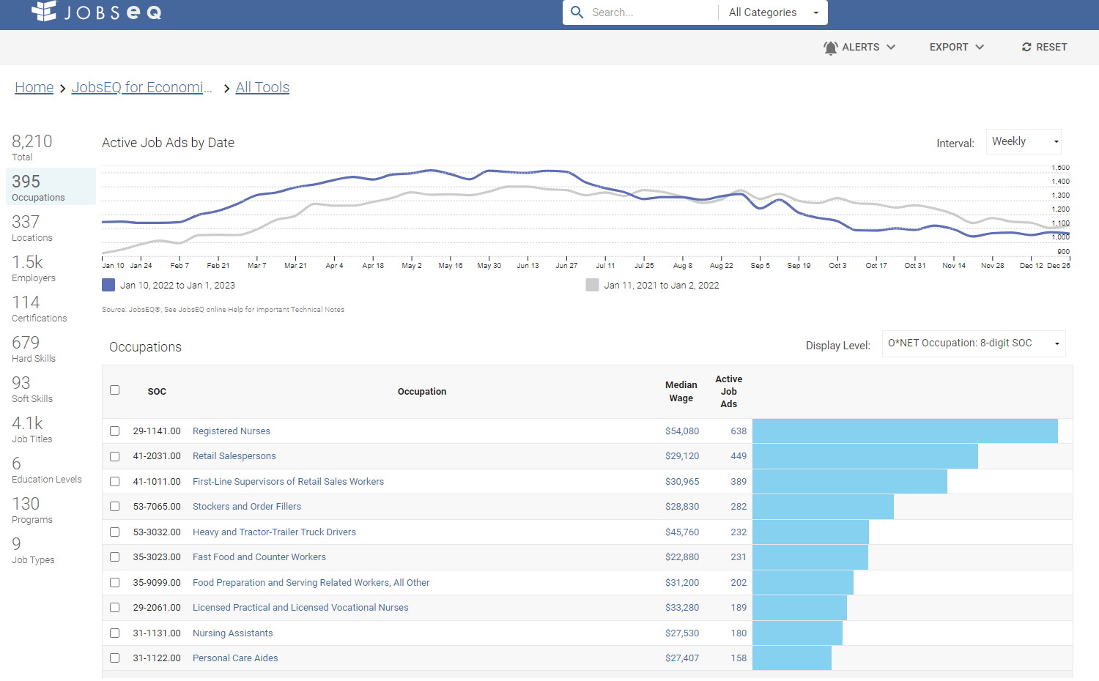
Job Posts in Carteret County -29% from Week of June 27

Slide 43
4 Health Care Companies in the Top Ten with Job Posts

Slide 44
2% of Ads Promote Remote Carteret County

Slide 45
How Will Carteret County Fair During a Recession? -10.8% Peak to Trough 2008 Recession

Slide 46
How Will Labor Shed Fair During a Recession? -11.4% Peak to Trough 2008 Recession

Slide 47
Conclusions
National Economy is Slowing
Recession is highly likely
Unemployment rate will rise and ease tight labor market
Sub-par growth will last for more than one year
Carteret County
Growing slower than the nation
Will also see slower growth due to recession
Working with educators is critical in this tight labor market

