Slide 1
A TALE OF TWO ECONOMIES IN 2024
Dr. Michael L. Walden, Reynolds Distinguished Professor Emeritus
North Carolina State University

Slide 2
REVIEW OF THE COVID RECESSION
RESULTED FROM NATIONWIDE SHUT-DOWN POLICIES
14% UNEMPLOYMENT
ECONOMY (GDP) DROPPED 33% ON ANNUALIZED BASIS
GOOD NEWS – SHORT LIVED – REBOUND BEGAN IN MAY 2020

Slide 3
GOOD NEWS – ECONOMY HAS RECOVERED
MOST MAJOR MEASURES ARE NEAR OR BEYOND PRE-COVID LEVELS
* TOTAL JOBS ABOVE PRE-PANDEMIC LEVEL
* UNEMPLOYMENT RATE UNDER 4%
* LABOR FORCE PARTICIPATION RATE INCREASING
* ECONOMY HAS BEEN GROWING

Slide 4
QUARTERLY REAL GDP GROWTH RATE, 2018-23

Slide 5
EMPLOYMENT TRENDS, 2003-2023

Slide 6
LABOR FORCE PARTICIPATION RATE, 2003-23

Slide 7
CHALLENGES DURING THE RECOVERY
LABOR SHORTAGES - FEAR OF PERSONAL INTERACTION
- SUBSTANTIAL GOVERNMENT SUPPORT
- WORKERS “UPSKILLED” AND TOOK BETTER JOBS
- LABOR FORCE PARTICIPATION TO TREND DOWNWARD
- 55 AND OVER GROUP IS STILL BELOW PRE-PANDEIMC
RISING INFLATION RATE
- SUPPLY CHAIN PROBLEMS
- MASSIVE FEDERAL SPENDING

Slide 8
WHY ARE PEOPLE UNHAPPY? WORKER “REAL”EARNINGS
* REAL EARNINGS: EARNINGS ADJUSTED FOR INFLATION (PURCHASING POWER)
* DOWN 9% FROM SPRING 2020 TO SPRING 2022
* UP 1.7% IN LATEST YEAR
* IMPLIES WILL TAKE 4 MORE YEARS TO TOTALLY RECOVER

Slide 9
GOOD NEWS: INFLATION HAS MODERATED
2.4% IN 2019, 9% IN 2022, NOW 3% TO 4% (all year-over-year)
BUT NOTE: MEANS AVERAGE RATE OF PRICE INCREASES HAVE
SLOWED; NOT THAT PRICES ARE FALLING

Slide 10
YEAR-OVER-YEAR CPI % CHANGE

Slide 11
THE FEDERAL RESERVE TO THE RESCUE?
MOVING THE PUNCH BOWL
CONTROL OVER INTEREST RATES AND MONEY SUPPLY
DURING COVID, PUSHED INTEREST RATES TO RECORD LOWS AND MONEY TO RECORD HIGHS TO ENCOURAGE SPENDING
NOW, FED HAS PUSHED INTEREST RATES UP AND REDUCED MONEY SUPPLY TO SLOW SPENDING AND TAKE PRESSURE OFF PRICES

Slide 12
FEDERAL FUNDS RATE, 1955-2023

Slide 13
FED IS ALSO REDUCING THE MONEY SUPPLY (M2 MONEY SUPPLY ADJUSTED FOR INFLATION)

Slide 14
WHAT’S THE WORRY?
THAT FED’S EFFORTS WILL CAUSE A RECESSION
RECESSION IS A “BROAD BASED DECLINE IN ECONOMIC ACTIVITY
FOR A SUSTAINED PERIOD OF TIME”
RECESSIONS ARE COMMON WHEN FED RAISES INTEREST RATES

Slide 15
CONSUMER SPENDING CARRIES THE ECONOMY
SUPPORTED BY COVID STIMULUS
PROGRAMS AND
“PENT-UP DEMAND” AFTER THE
PANDEMIC;
CONSUMER SPENDING HAS BEEN
SURPRISINGLY STRONG

Slide 16
BUT NOW COVID SAVINGS ARE GONE, AND BOTH CREDIT CARD DEBT AND INTEREST RATES ARE UP

Slide 17
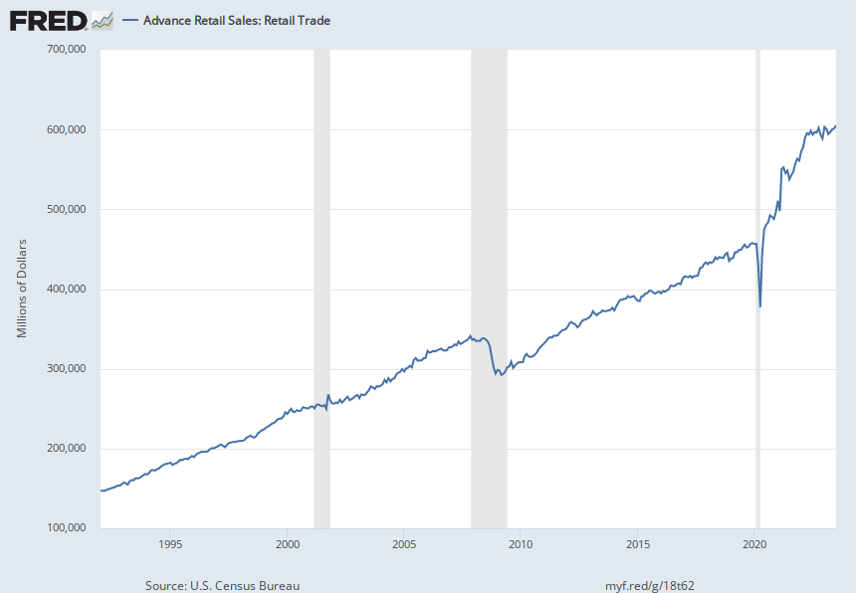
CONSUMER SPENDING IS SLOWING

Slide 18
JOB GROWTH IS ALSO SLOWING
AVERAGE MONTHLY NET JOB GAIN
2ND HALF, 2020: 1,346,000
2021: 667,000
2022: 369,000
2023 , JAN-OCT: 200,600

Slide 19
FEDERAL RESERVE IS TRYING TO ACHIEVE A “SOFT LANDING” MEANING REDUCE INFLAITON RATE WITHOUT A RECESSION

Slide 20
SOFT LANDINGS HAVE BEEN RARE
THERE HAVE BEEN
12 RECESSIONS
SINCE WORLD WAR II
THERE HAS BEEN ONLY
1 SOFT LANDING
SINCE WORLD WAR II

Slide 21
2024 WILL BE A YEAR OF TWO ECONOMIES
FIRST HALF
FED KEEPS INTEREST RATES HIGH
ECONOMY SLOWS MORE
GROWTH MAY BE NEGATIVE
JOBLESS RATE RISES TO 5%
SECOND HALF
FED REDUCES INTEREST RATES
GROWTH REVIVES
GROWTH RATE RETURNS TO 2%
JOBLESS RATE DROPS TO 3.5%

Slide 22
WILL WE HAVE A RECESSION IN EARLY 2024?
THE “CALL” IS MADE BY AN ORGANIZATION NAMED THE
”NATIONAL BUREAU OF
ECONOMIC RESEARCH"
THEIR DEFINITION:
“A SIGNIFICANT DECLINE IN ECONOMIC ACTIVITY THAT IS BROAD BASED AND LASTS FOR A SIGNIFICANT PERIOD OF TIME

Slide 23
TRENDS IN INTEREST RATES AND DEBT COULD POINT TO A “REAL RECESSION”

Slide 24
WHAT SECTORS WILL BE MOST IMPACTED FROM A SLOWDOWN OR A RECESSION?
COMMERICAL REAL ESTATE
FINANCIAL SERVICES
MANUFCTURING
RESIDENTIAL REAL ESTATE
LEISURE ACTIVITIES

Slide 25
HOW WILL NORTH CAROLINA AND CARTERET CO. DO? LOOK AT PREVIOUS RECESSIONS
% JOB CHANGE DURING RECESSION
2008-2010 RECESSION 2020 RECESSION
US -6.2% -14.2%
NC -8.1% -12.2%
CARTERET CO. -10.0% -22.5%

Slide 26
CARTERRET COUNTY & NC TOP INDUSTRIES
CARTERET COUNTY: REAL ESTATE, GOVERNMENT, TOURISM, PROFESSIONAL SERVICES
(Gov’t includes military)
NORTH CAROLINA: MANUFACTURING, REAL ESTATE, FINANCE, PROFESSIONAL SERVICES

Slide 27
RECENT CARTERET COUNTY TRENDS % CHANGE IN VALUE OF PRODUCTION, 2017-2022
SECTORS WITH BIGGEST INCREASES SECTORS WITH LARGEST DECLINES
MINING AND QUARRING AGRICULTURE
PROFESSIONAL AND BUSINESS SERVICES WHOLESALE TRADE
HEALTH CARE MANUFACTURING
CONSTRUCTION EDUCATIONAL SERVICES

Slide 28
BIG ISSUE #1: NATIONAL DEBT
PUTS UPWARD PRESSURE ON INTEREST RATES
CROWDS OUT PRIVATE BORROWING
ONE APPROACH: DIVIDE FEDERAL SPENDING INTO A “CURRENT BUDGET” AND “CAPITAL BUDGET”

Slide 29
BIG ISSUE #2: SOCIAL SECURITY
ESTIMATED THAT BY 2033 WILL ONLY BE ABLE TO PAY 75% OF WHAT PROMISED
GETS WORSE AS TIME PROGRESSES
LOOK FOR A COMMISSION IN EARLY 2030’S TO ADDRESS THE PROBLEM

Slide 30
NEW BOOK AVAILABLE NOW: “THE 60 MINUTE INVESTMENT GUIDE”

